Slide 1
MediTrack
▪ Group Members:
1. Name: Sazzad Hossain Sabbir
Id: 1612229042
2. Name: Tahmina Akter Tania
Id: 1611414642
3. Name: Ria Sarkar
Id:1620576042

Slide 2
MediTrack:
A mobile application.
For patient, aged and sick people.
Notifying a person about their medicine taking time as their given input.
Keeping track on medicine and notify for taking medicine.
Reminding about their doctor’s checkup schedule.

Slide 3
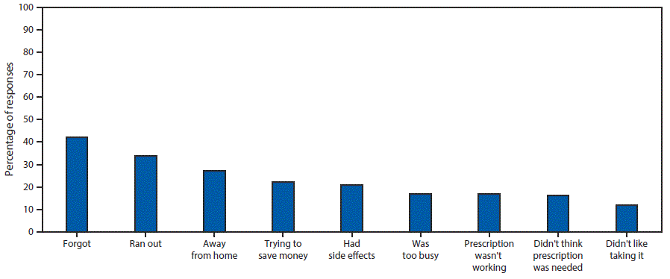
From the following chart we can easily understand that how helpful will be this application towards us.

Slide 4
Why this application is different from other existing application?
There are some mobile application program that are found in google play store by which people can manage a clinic or hospital about their stock limits of medicines.
There are some other application program in google play store which provides the service to people that, anybody who will install those application program in their device they can easily know the name of medicines that they will need to get cured from some disease in any emergency situation as a primary treatment.
But the matter of sorrow is, there is not available any application or any software that can look after or maintain the medicine schedule of a particular patient in a day or to remind him/her about that person’s medicine stock or medicine taking time.

Slide 5
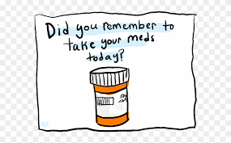
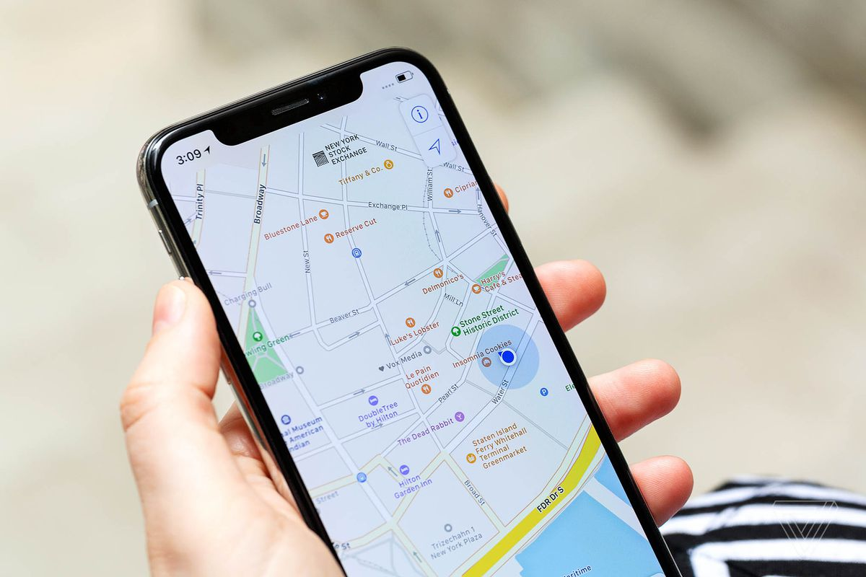
Our Mission:
Reminding people about medicines.
Tracking current stock of the required medicines.
Getting the location of the nearest chemist shop.
Scheduling appointments at the nearest hospital.

Slide 6
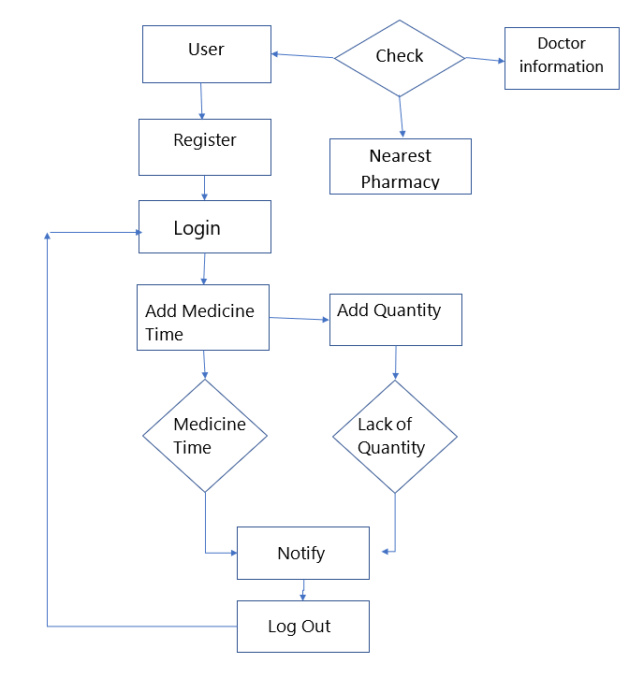
Flow Chart:

Slide 7
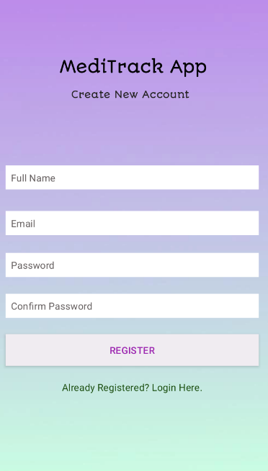
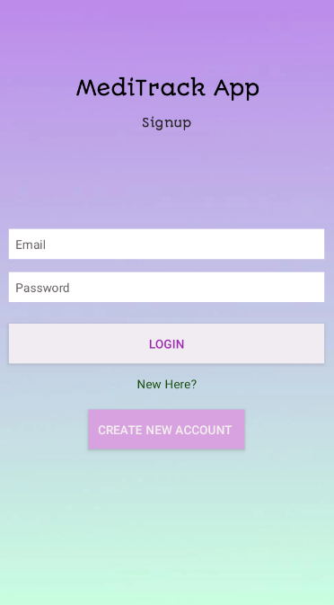
Features:
Login/Signup: User can signup if they are new in the application or they have already an account they can simply login.
Register Login

Slide 8
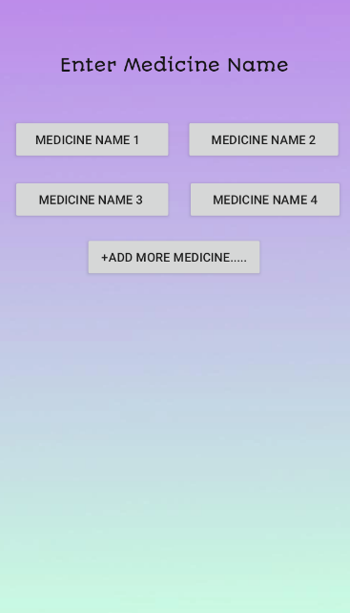
Features:
Medicine Details : User can add medicine information.
1. Medicine Name
2. How many times in a day
3. Quantity of medicine
Application will notify user as their inserted
Information.
Medicine List

Slide 9
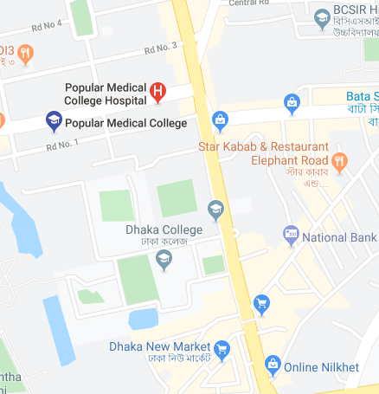
Features:
Doctor information: User can see the doctor name, doctor’s chamber, specialist , visiting hours and contract number of chamber. User can see this information even without login.
Pharmacy Location: User can find their nearest pharmacy location from the map.
Map

Slide 10
Required Platforms & Programming Language:
Html
Xampp
Android Studio

Slide 11
Limitation:
Internet connection is required.
Work in only android smart phone.
Users need to be educated to operate this app.

Slide 12


